Slide 1

ANTWEIGHT BATTLE BOT
The Grainger College of Engineering
Ishanvi Lakhani, Megha Esturi, Deepika Agrawal
27th November, 2024

Slide 2

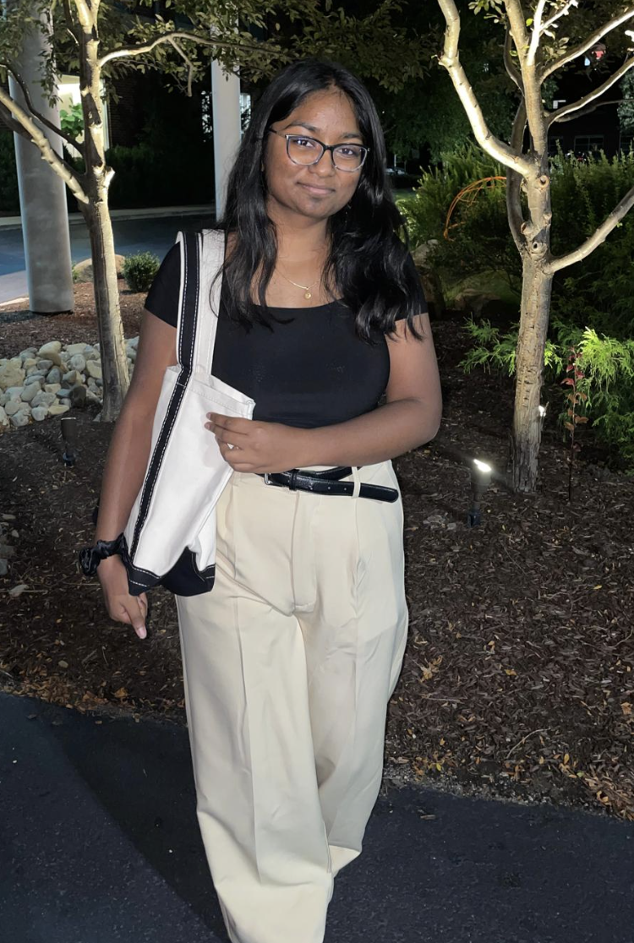

TEAM MEMBERS
Ishanvi Lakhani
Megha Esturi
Deepika Agrawal
UNIVERSITY OF ILLINOIS URBANA-CHAMPAIGN
GRAINGER ENGINEERING

Slide 3
TEAM PROJECT – ANTWEIGHT BATTLE BOT
Weight should be under 2lbs
3D printed using PLA+ plastic
Flipper arm as the defense mechanism
Communicates with the PC using over WIFI
UNIVERSITY OF ILLINOIS URBANA-CHAMPAIGN
GRAINGER ENGINEERING

Slide 4
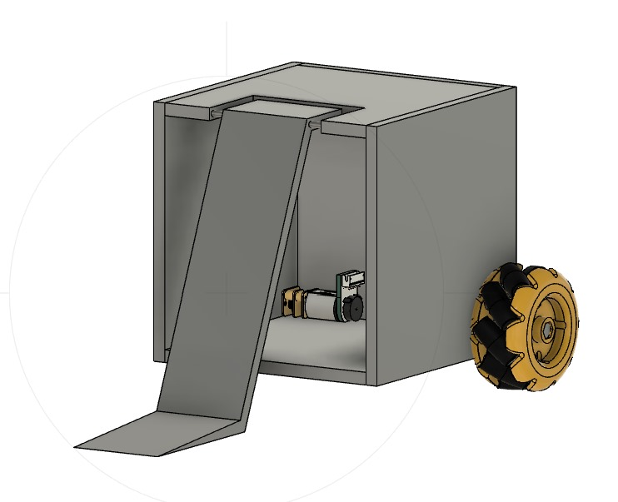
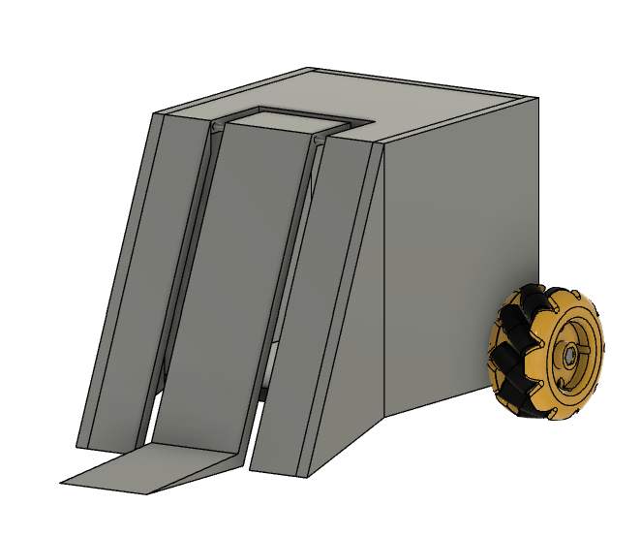
ORIGINAL DESIGN
Unbalanced as only 2 wheels at the back
Over 2lbs since extra motor for the flipper arm
Defense only on one side - weak defense
Flipper arm unable to lift 2lbs
UNIVERSITY OF ILLINOIS URBANA-CHAMPAIGN
GRAINGER ENGINEERING

Slide 5
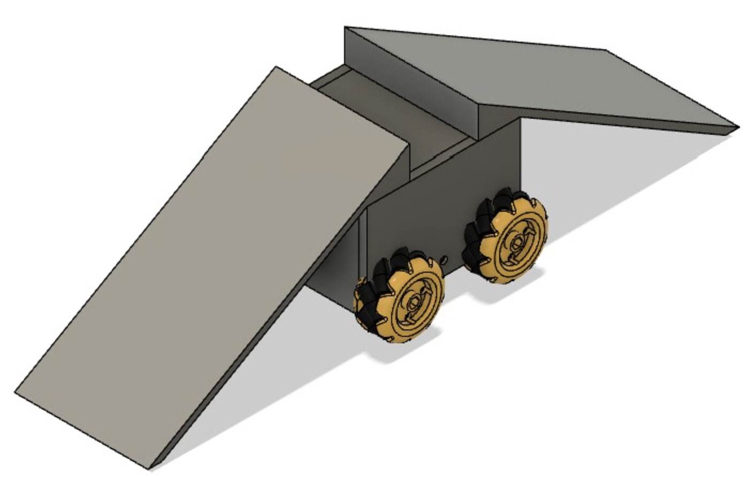
NEW AND UPDATED DESIGN
Well balanced – 4 wheel drive
Under 2lbs – no extra motors required
Flipper arms causes opponent to destabilize
Defense on both sides
UNIVERSITY OF ILLINOIS URBANA-CHAMPAIGN
GRAINGER ENGINEERING

Slide 6

KEY RESPONSIBILITIES
UNIVERSITY OF ILLINOIS URBANA-CHAMPAIGN
GRAINGER ENGINEERING

Slide 7
DEEPIKA AGRAWAL
Design the CAD model
3D print all requirement equipment – including the chassis
Work on setting up the flipper arm and verify its functionality
Help set up PCB
UNIVERSITY OF ILLINOIS URBANA-CHAMPAIGN
GRAINGER ENGINEERING

Slide 8
MEGHA ESTURI
Establish the WiFi Connection between the ESP32 and the PC
Ensure motors and motor drivers respond to signals sent by the PC and move accordingly
Work on setting up the flipper arm and verify its functionality
Assist with review of 3D CAD model
Routing of the PCB
UNIVERSITY OF ILLINOIS URBANA-CHAMPAIGN
GRAINGER ENGINEERING

Slide 9
ISHANVI LAKHANI
Research into all electronic components
Make the PCB schematic
Understand connection between the ESP32, motor drivers, and motors
Assist with review of 3D CAD model
Help setup the PCB
UNIVERSITY OF ILLINOIS URBANA-CHAMPAIGN
GRAINGER ENGINEERING

Slide 10
BLOCK DIAGRAM AND SUBSYTEM REQUIREMENTS
UNIVERSITY OF ILLINOIS URBANA-CHAMPAIGN
GRAINGER ENGINEERING

Slide 11
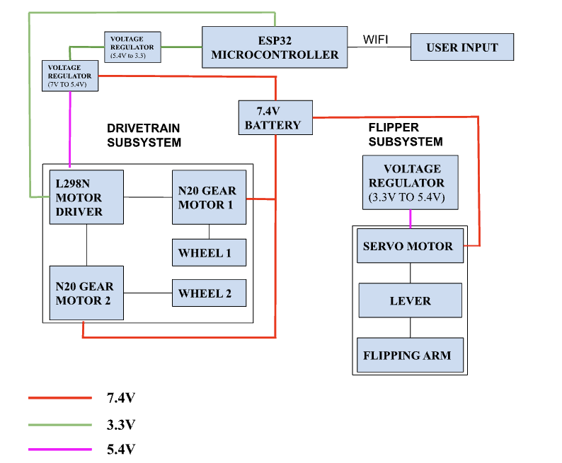
BLOCK DIAGRAM
UNIVERSITY OF ILLINOIS URBANA-CHAMPAIGN
GRAINGER ENGINEERING

Slide 12
DRIVE-TRAIN SUBSYSEM
REQUIREMENTS | VERIFICATION
The motors and motor drivers must effectively communicate with the microcontroller to relay user commands. | Try the commands and see if the motor and motor driver are able to effectively perform those functions.
The motors and motor drivers must operate efficiently with a 9V. | Measure the voltage supplied to the motors. Verify that the voltage is between 7.5 - 9V range during operation.
The wheels must enable the robot to move at a sufficient speed, achieving an RPM of approximately 100 - 460. | Manually measure RPM by counting the number of wheel rotations in a fixed period of 10 seconds and multiply by 6 to get the RPM. Ensure the measured RPM falls between 100 - 460 for effective mobility.
UNIVERSITY OF ILLINOIS URBANA-CHAMPAIGN
GRAINGER ENGINEERING

Slide 13
FLIPPING SUBSYSEM
REQUIREMENTS | VERIFICATION
Flipping Force: The arm and spring mechanism should generate enough force to flip the opponent robot. | Place a weight equivalent to the opponent robot on the flipping mechanism and trigger the flip. Verify the mechanism generates sufficient force to flip the weight.
UNIVERSITY OF ILLINOIS URBANA-CHAMPAIGN
GRAINGER ENGINEERING

Slide 14
POWER SUBSYSEM
REQUIREMENTS | VERIFICATION
The subsystem must include a 9V battery to power the bot for the duration of the battle. | Measure the battery capacity using a battery tester. Simulate a typical battle load and measure power consumption during a test run and monitor runtime.
UNIVERSITY OF ILLINOIS URBANA-CHAMPAIGN
GRAINGER ENGINEERING

Slide 15
POWER SUBSYSEM
REQUIREMENTS | VERIFICATION
The subsystem must include a 9V battery to power the bot for the duration of the battle. | Measure the battery capacity using a battery tester. Simulate a typical battle load and measure power consumption during a test run and monitor runtime.
UNIVERSITY OF ILLINOIS URBANA-CHAMPAIGN
GRAINGER ENGINEERING

Slide 16
CONTROL SUBSYSEM
REQUIREMENTS | VERIFICATION
The ESP32 must support WiFi communication with a throughput of at least 5 Mbps for reliable control of motors and weapons. | Use a WiFi benchmark tool or test sketch to send/receive data over WiF and measure the throughput and verify it reaches at least 5 Mbps consistently during operation.
The latency should be between 50-100 ms for responsive control, with a preferred range of 35-60 ms. | Print latency to a connected screen and log the average latency during operation.
Must provide 6 GPIO pins, including 2 PWM pins for speed control of motors. | Check ESP32 pinout diagram and map at least 6 GPIO pins.
UNIVERSITY OF ILLINOIS URBANA-CHAMPAIGN
GRAINGER ENGINEERING

Slide 17
SUCCESSSES AND FAILURES OF THE PROJECT
Battle Bot is under 2lbs
3D printed using PLA+ plastic
Defense Mechanism – Flipper arm
UNIVERSITY OF ILLINOIS URBANA-CHAMPAIGN
GRAINGER ENGINEERING

Slide 18
WHAT WE WOULD DO DIFFERENLTY
Establish concrete deadline for the CAD design
Make the ramps shorter so overall design is compact - easier to maneuver
UNIVERSITY OF ILLINOIS URBANA-CHAMPAIGN
GRAINGER ENGINEERING

Slide 19
ANY QUESTIONS?

